Slide 1
Software Project Management
Chapter 4. Project Schedules

Slide 2
Building the Project Schedule
The project schedule is a calendar that links the tasks to be done with the resources that will do them.
There are many project scheduling software products that can do much of the tedious work of calculating the schedule automatically, and plenty of books and tutorials dedicated to teaching people how to use them.
However, before a project manager can use these tools, he should understand the concepts behind the WBS, dependencies, resource allocation, critical paths, Gantt charts, and earned value.

Slide 3
Allocate Resources to the Tasks
The first step in building the project schedule is to identify the resources required to perform each of the tasks.
A resource is any person, item, tool, or service that is needed by the project that is either scarce or has limited availability.
One or more resources must be allocated to each task. To do this, the project manager must first assign the task to people who will perform it.
Some tasks may require more than one person to be assigned to them—the effort for the task should be divided among those resources.

Slide 4
Effort and Duration
The project manager must keep in mind the difference between effort and duration.
Duration is the amount of time that elapses between the time the task is started and the time it is completed, measured in hours.
Effort is measured in person-hours (or person-days, person-weeks, etc.), and represents the total number of hours that each person spent working on the task.

Slide 5
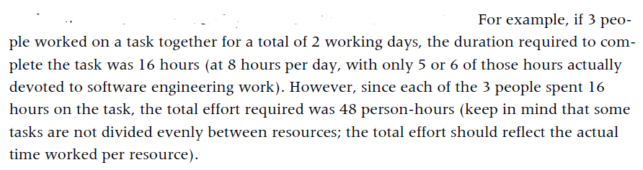

Slide 6
Continue…
It’s possible to allocate one resource to two tasks simultaneously by assigning a percentage of the resource’s time to each task.
When the task stretches over several days, but the resource is needed only for part of each day or a few days of the task, that resource can be assigned part-time to the task.
For example, a resource can be 50% allocated to two tasks, or 30% allocated to one task and 70% to another, etc.

Slide 7
Continue…
Resource allocation is often the most difficult and time-consuming part of effective project management, because it requires the project manager to know the team.
There is no hard and-fast rule for deciding who is allocated to which task.
This is a decision that requires a great deal of attention to the skill sets of the people on the team and to their personal motivation.

Slide 8
Identify Dependencies
Once resources are allocated, the next step in creating a project schedule is to identify dependencies between tasks.
A task has a dependency if it involves an activity, resource, or work product that is subsequently required by another task.
The project manager should start by taking the WBS and adding dependency information to it: each task in the WBS is given a number, and the number of any task that it is dependent on should be listed next to it as a predecessor.

Slide 9
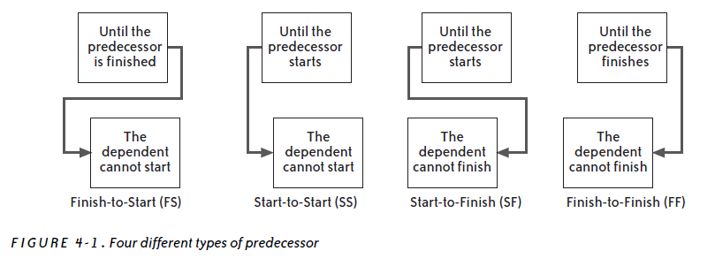

Slide 10
Continue…
If Wideband Delphi is used to generate estimates, many of these dependencies will already be represented in the assumptions.
There are many reasons why one task may be dependent on another.
The easiest way to maintain the resource allocations and dependencies is to use a project management software package.

